Slide 1
Mapping Distribution Centers
Cole Anderson, GIS 5578

Slide 2
Motivation for the project
-Neel, Phillip (2015.) Logistics Cities: Poverty, Immigration, and Employment in Seattle’s Southern Suburbs. University of Washington, Seattle, United States.
-GEOG 3331: Global Economy

Slide 3


Slide 4
Sourcing the Data
NHGIS IPUMS Downloads Center
- 2008-12, 2010-14, 2013-17
- .csv by ZCTA (ZIP Code Tabulation Area)
-.shp by ZCTA
U.S. Census: County Business Patterns
- 2010, 2012, 2015
- .txt by ZIP code

Slide 5
Modules
CSV: used to read and write initial ZCTA csv header to re-assign names from codebook
Ordered Dict: used to store key:value pairs to re-assign names ZCTA csvs
Pandas: used to read, rename, merge ZCTA and ZIP data into single sheet, then drop unneeded data rows and columns
Geopandas: used to join data sheets to shapefiles, calculate percents and LQ, and interface with PLT for coefficient and map making
Matplotlib: interfaces with Geopandas and to create choropleth maps

Slide 6
Methods, analysis techniques, model, and code
Functions examples:
WriteFile
JoinDemoToIndustry
JoinStatstoSHP
CorrMeasures
Analysis Inputs + Why:
LQ + Correlation Calculation
Joining + Merging
Calculated Columns
Changing headers via dictionary
Loops
Purpose of Code
Rename relevant CSV headers
Join data for demography, industry for each ZCTA
Join data to shapefiles
Calculate LQ for each ZCTA
Calculate R-value between each demography and LQ
Map of LQs
Repeat for 3 years

Slide 7
Code
def JoinStatstoSHP(JoinedFile, inshpfile, outshpfile):
gdf= geopandas.read_file(inshpfile)
df= pd.read_csv(JoinedFile)
gdf= gdf.merge(df, on ='GISJOIN')
gdf['pct black'] = (gdf['Black or African American alone']/gdf['Total_y'])*100
gdf['pct white'] = (gdf['White alone']/gdf['Total_y'])*100
gdf['pct frgn'] = (gdf['Foreign-Born']/gdf['Total_y'])*100
totalAllPlants = gdf['all industry count'].sum()
total45411xPlants = gdf['45411x industry count'].sum()
gdf['LQ'] = (gdf['45411x industry count']/gdf['all industry count'])/(total45411xPlants/totalAllPlants)
gdf.to_file(outshpfile)

Slide 8
Data Process Model
Correlations and Maps
Column Div.
LQ and Percent Cols.
Rename CSV header.
ZCTA1_csv
NHGIS extract
Race/Income by ZCTA
MERGE
ZCTAmerge
Demography by ZCTA
SHP File
Joined SHP File
NHGIS extract
Nativity by ZCTA
JOIN
ZCTA2_csv
MERGE
Final
Rename CSV header.
Delete
+
Group
ZIP1_csv
45411x counts by ZIP
CBP extract
Industry counts by ZIP
ZIPmerge
Counts by ZIP
MERGE
ZIP1_csv
Total counts by ZIP
Group

Slide 9
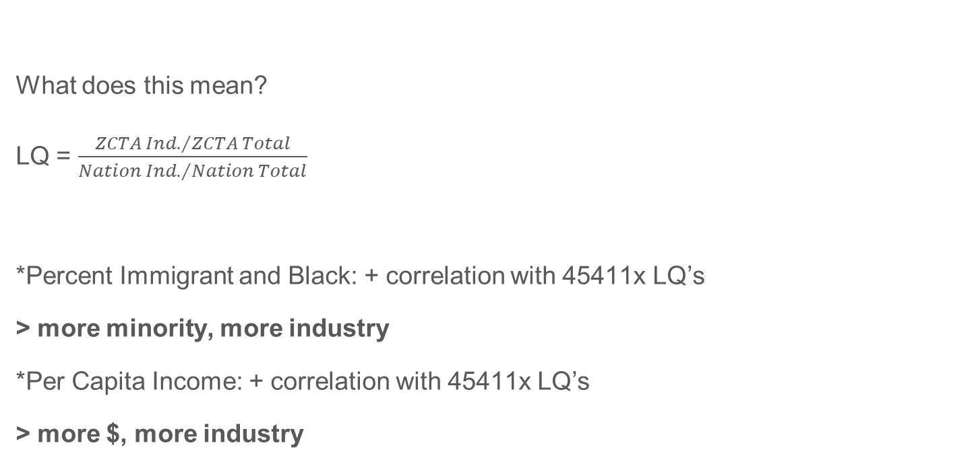
Analysis and Outcomes
What does this mean?
LQ = $\frac{{ZCTA Ind.}/{ZCTA Total}}{{Nation Ind.}/{Nation Total}}$
*Percent Immigrant and Black: + correlation with 45411x LQ’s
> more minority, more industry
*Per Capita Income: + correlation with 45411x LQ’s
> more $, more industry
Correlation R-values | Percent Foreign Born | Percent Black | Per Capita Income
2010 | .1935 | .1267 | .1052
2012 | .0956 | .0588 | .1180
2015 | .0011 | .0026 | .1060

Slide 10
But these are weak and with no causation…

Slide 11
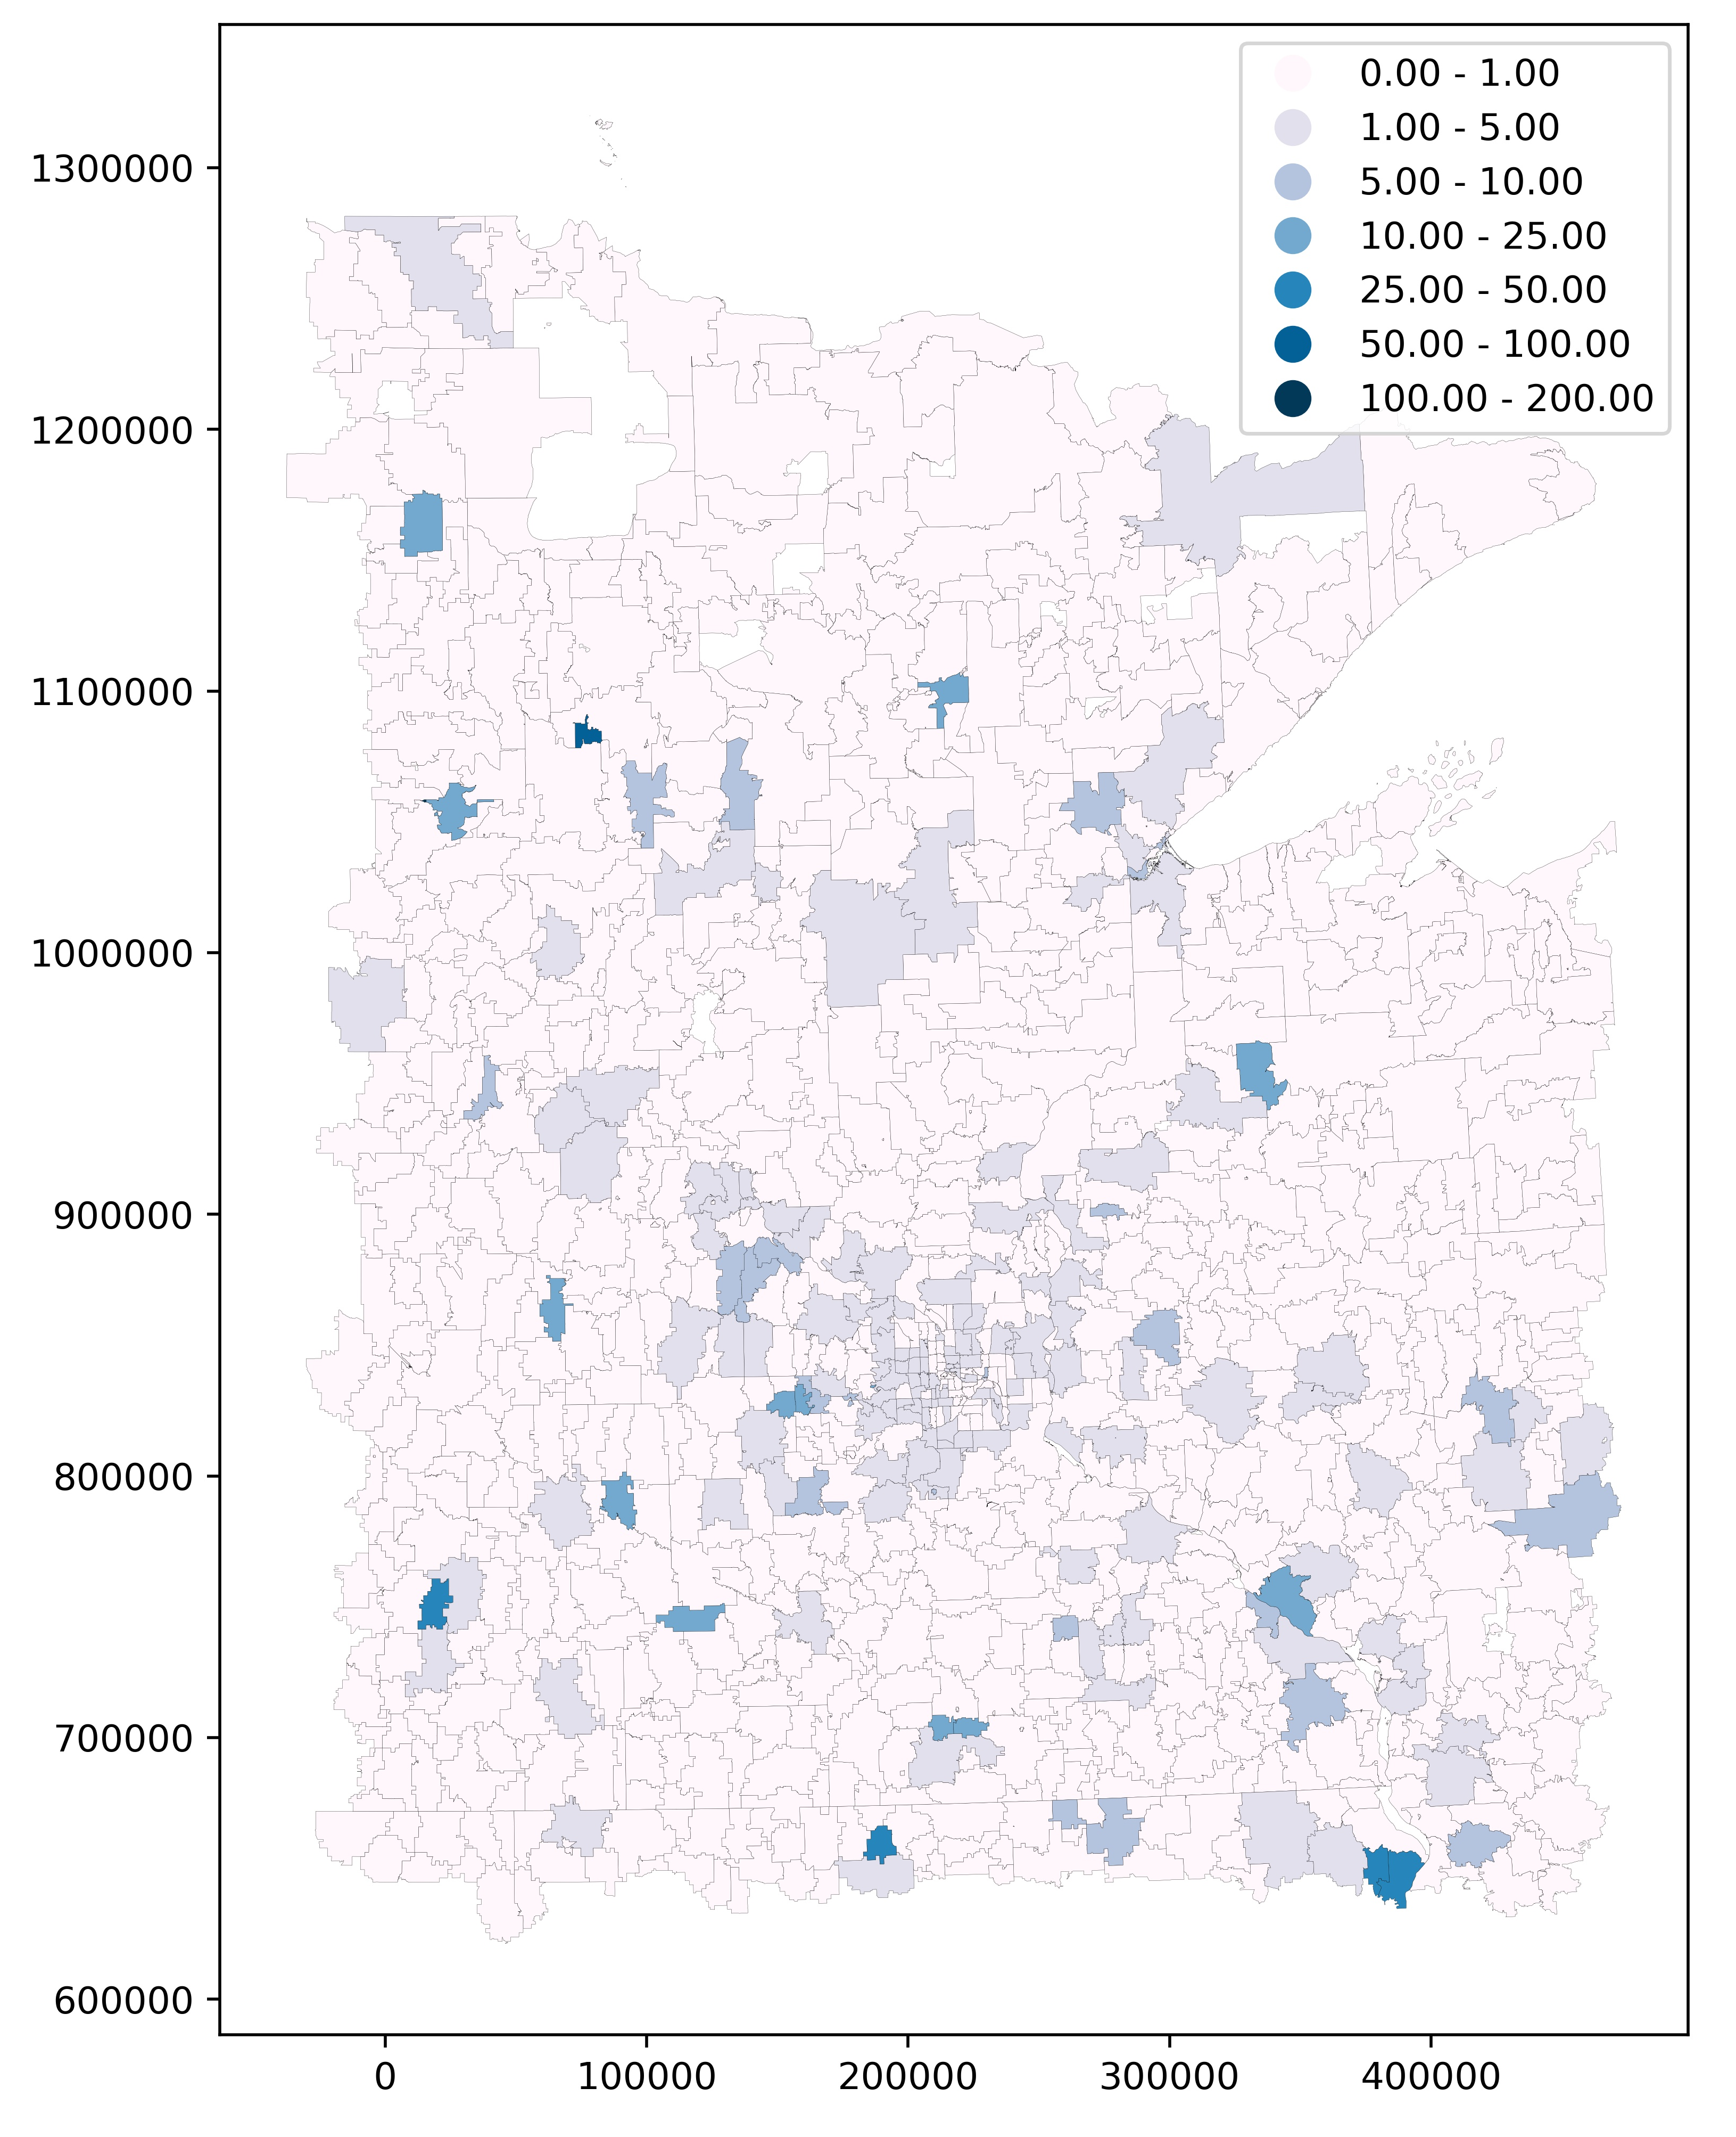
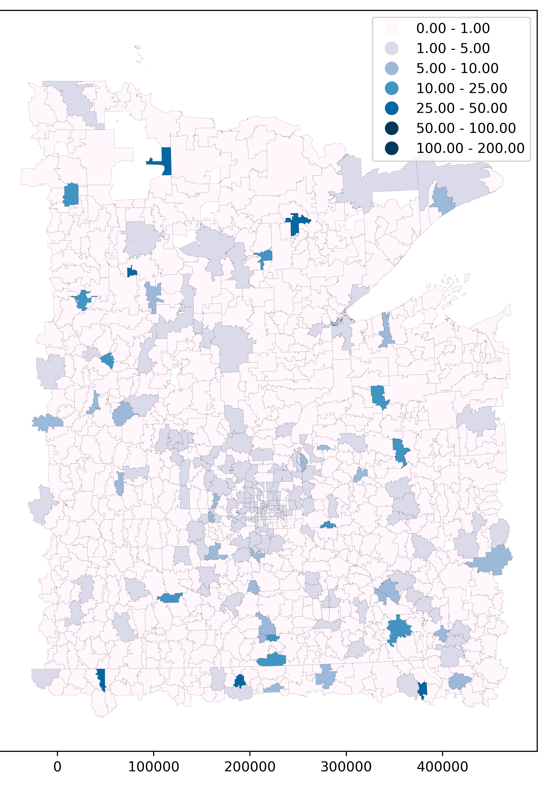
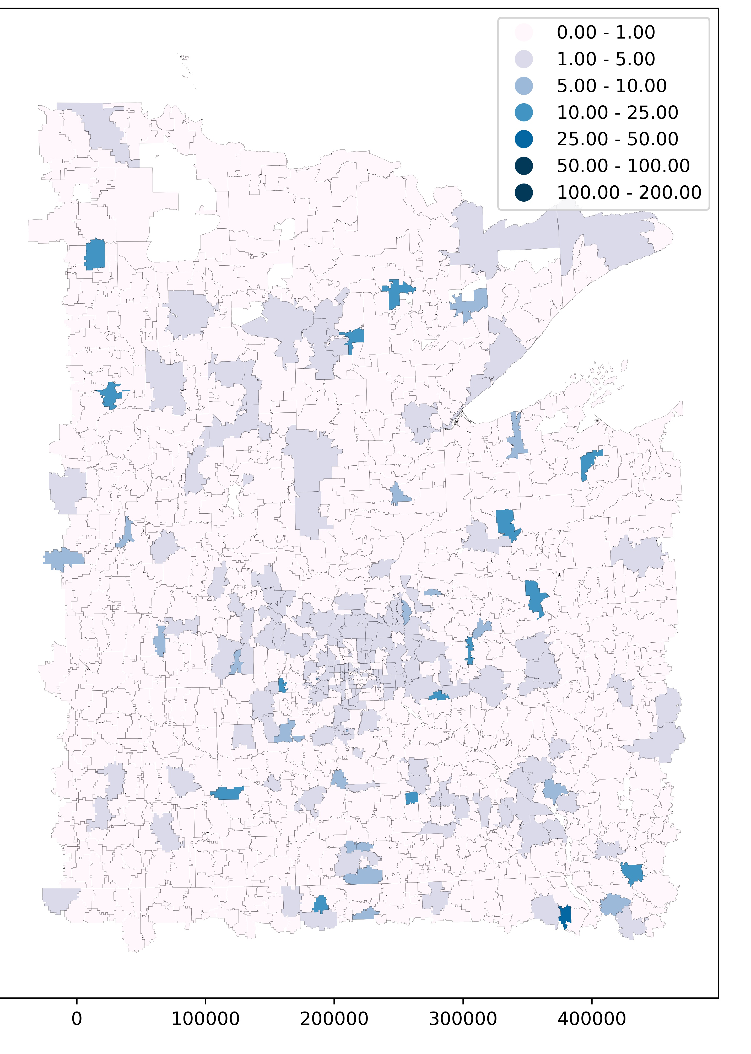
LQ by ZCTA

Slide 12
Post-Op: Challenges and Lessons
Clusters, I don’t understand them
Geopandas won’t work in ARC Spyder
Many file lists to deal with; best practices?
ARCpy makes poor maps that are hard to control
Write comments AS YOU GO
Data research is always a bigger project than anticipated
What’s signicant?

